Slide 1

Business Advisory Start Frozen Yogurt Business
Prepared by: Ahmed Nassar

Slide 2
Business Problem
Problem Statement
The Business problem is to consider a customer who wants to open a Frozen Yogurt Shop in specific area
For our testcase we are going to use Austin as a city to start the new business

Slide 3
Requirements
The customer require to predict the best area to start a frozen yogurt business in Austin

Slide 4
Background
Planning ahead and investment prediction is major problem in today's AI world. Customers require to understand the market and have a clear prediction about their business even before any investment. Using the current available data on how other business in the same business domain and in the same area will clarify how the current business statement and how it will be in future

Slide 5
Data Description
How many frozen yogurt/dessert shops in this city
How many customers per day going into these shops
How many customers going in weekends
Try fetch data for an entire year

Slide 6
Get Number and Names of Frozen Yogurt Shops in Austin Texas
 | ven_city | ven_id | ven_lat | ven_lng | ven_name
0 | Austin | 4b7cc2dff964a52078a42fe3 | 30.281256 | -97.740738 | TCBY
1 | Buda | 5c71cefddee770002c369982 | 30.082615 | -97.823440 | Freddy’s Frozen Custard & Steakburgers
2 | Austin | 58bc85a151d19e7f8b44ad9b | 30.394837 | -97.749304 | Menchie's at Great Hills
3 | Austin | 553ce4f7498e9ba5843cb7e9 | 30.299627 | -97.721174 | Menchie's Frozen Yogurt
4 | Pflugerville | 57afc76d498e1ecd88d497b5 | 30.461910 | -97.598716 | Menchie's

Slide 7
Get Number and Names of Dessert Shops in Austin Texas
 | ven_city | ven_id | ven_lat | ven_lng | ven_name
0 | Austin | 4d780e87ece5a1cddcd58fa4 | 30.264501 | -97.744821 | Berry Austin
1 | Austin | 5af79581f8cbd400394cf2a3 | 30.267235 | -97.752750 | The Baked Bear
2 | Austin | 4e9cb24446904f8f933fc63b | 30.255654 | -97.762526 | Lick Ice Creams
3 | Buda | 5c71cefddee770002c369982 | 30.082615 | -97.823440 | Freddy’s Frozen Custard & Steakburgers
4 | Austin | 4b25904af964a520db7324e3 | 30.391411 | -97.713988 | Culver's

Slide 8
Get Number and Names of Frozen Yogurt Shops in Paris, France
 | ven_city | ven_id | ven_lat | ven_lng | ven_name
0 | Paris | 4ff07da4e4b0b61f2a827eb3 | 48.859083 | 2.353587 | Yogurt Factory
1 | Paris | 5acf7c0fe1f2284dc91e44f7 | 48.853889 | 2.337537 | California Bliss
2 | Paris | 535bc50f11d260e3a8777a7a | 48.861782 | 2.351140 | l'atelier des glaces
3 | Paris | 539563e9498ecef183248e49 | 48.852635 | 2.335917 | Dip & Go
4 | Paris | 57cac9cd498e41a4a5d021cb | 48.861485 | 2.352987 | Yogurt Factory

Slide 9
Get Number and Names of Dessert Shops in Paris, France
 | ven_city | ven_id | ven_lat | ven_lng | ven_name
0 | Paris | 5b81a899249623002cbde2b3 | 48.854110 | 2.349764 | Amorino
1 | Paris | 4bc5e23151b376b0ce8e1a6f | 48.871036 | 2.303276 | Ladurée
2 | Paris | 4b1d1a75f964a520e00b24e3 | 48.866578 | 2.325459 | Pierre Hermé
3 | Paris | 5a3e6731b04056376864ad46 | 48.871514 | 2.303698 | 86 Champs (L'Occitane x Pierre Hermé)
4 | Paris | 4adcda14f964a5203a3721e3 | 48.863438 | 2.287255 | Carette

Slide 10
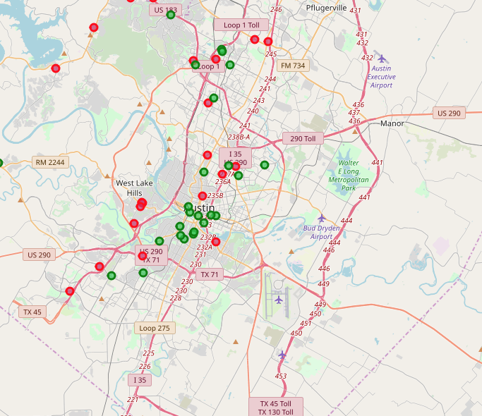
Austin Map
The red circles represent the frozen yogurt shops
The green circles represent the dessert shops
Dessert is parent category of frozen yogurt

Slide 11
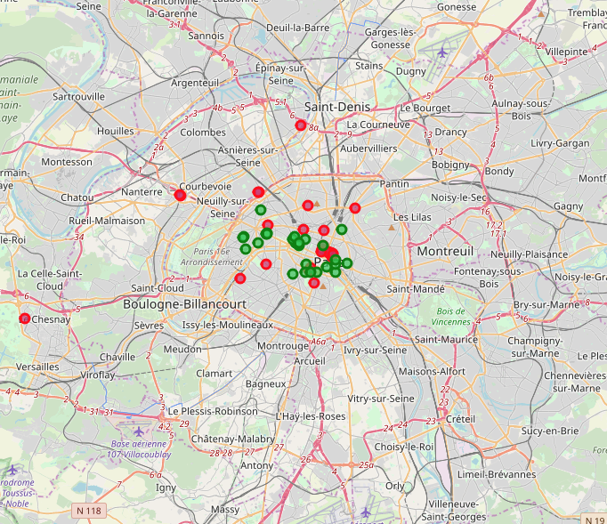
Paris Map
The red circles represent the frozen yogurt shops
The green circles represent the dessert shops
Dessert is parent category of frozen yogurt

Slide 12
Conclusion
Observation
As it can be noted by compare between the Austin and Paris maps, that is clear the frozen yogurt shops are concentrated in the cities downtown and very little fare away from the cities downtowns.
Recommendation
My recommendation to the customer that the best area to open a forzen yogurt shop should be around the cities downtown not far away from that.

